Slide 1
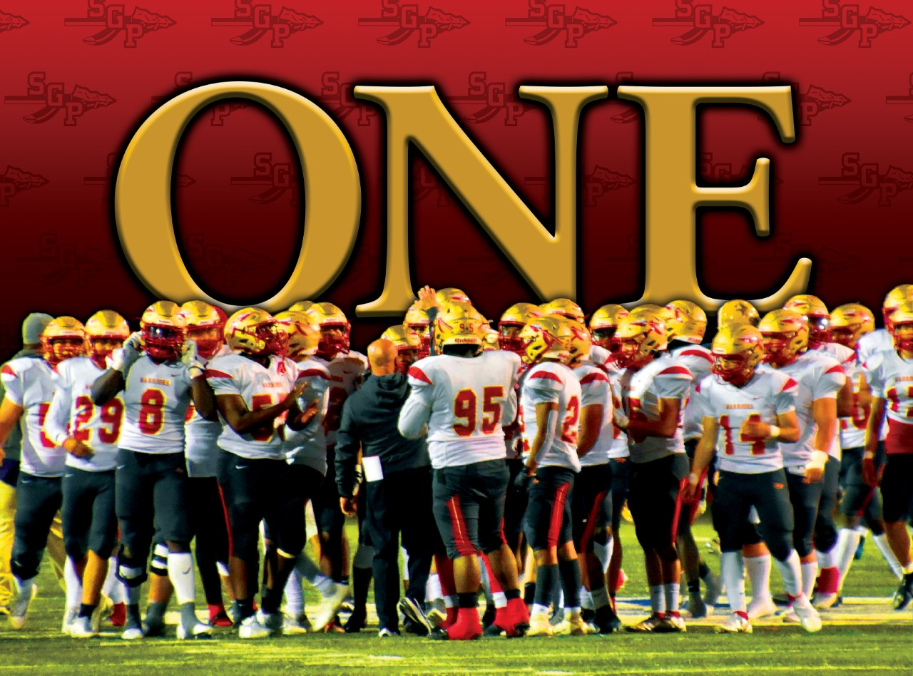

Slide 2
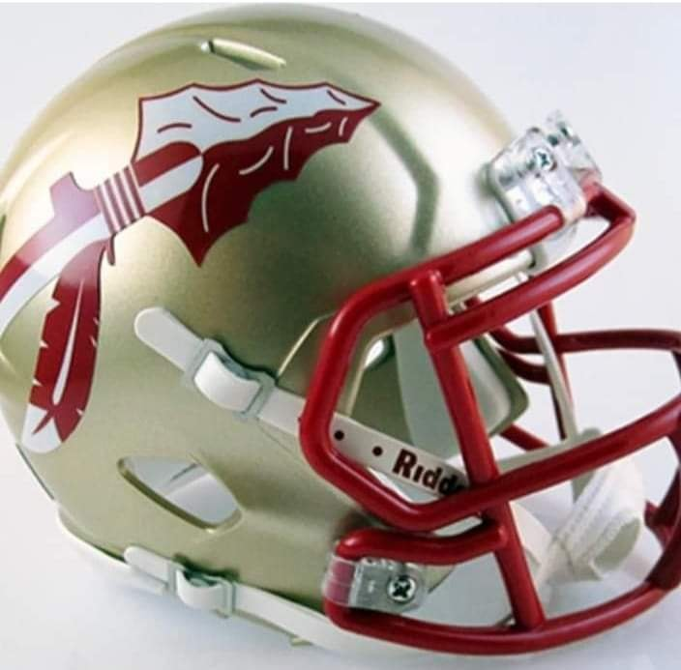
2025 SGP Warriors
Freshman Orientation

Slide 3
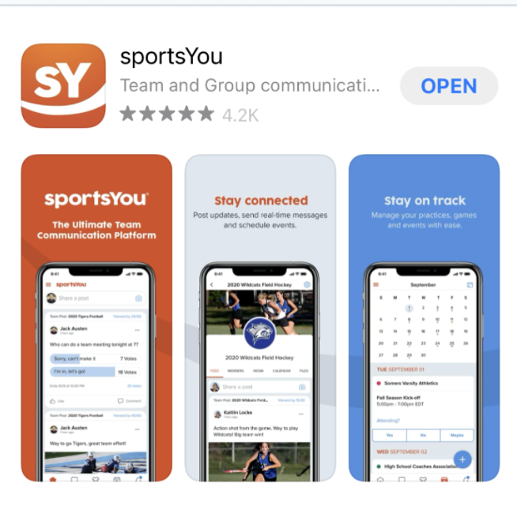
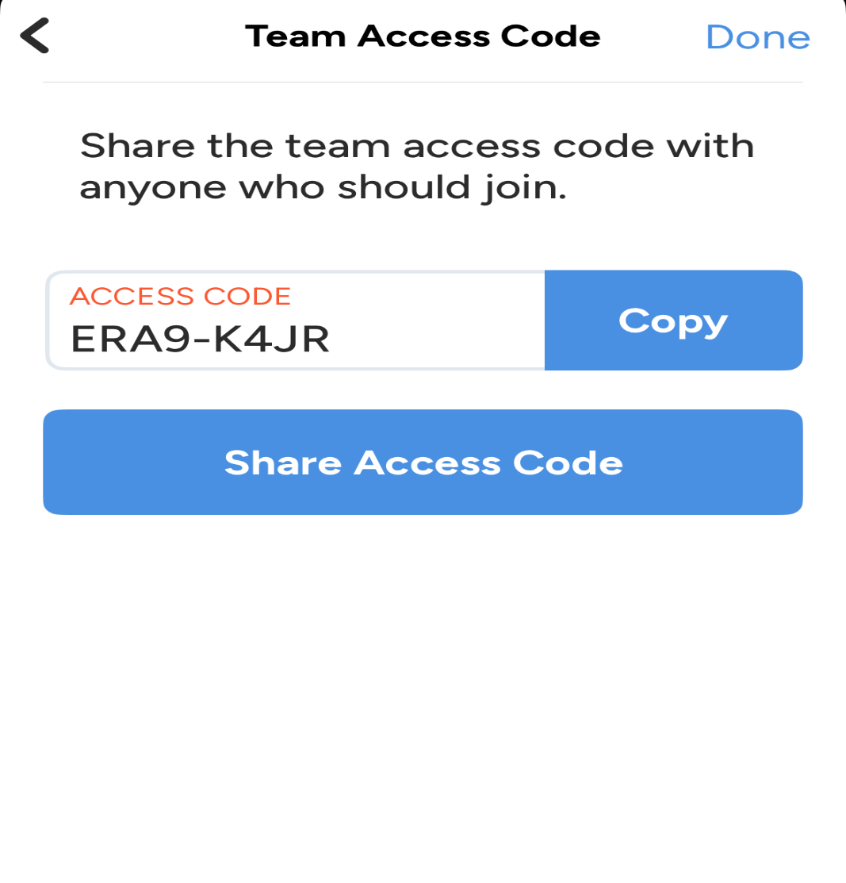
sportsYou class of 2029

Slide 4
Laban DeLay
Athletic Coordinator / Head Football laban.delay@gpisd.org

Slide 5
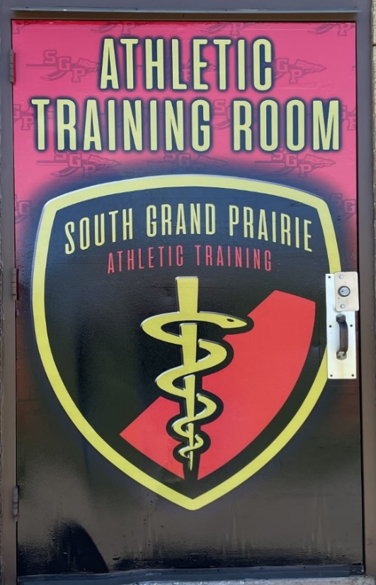
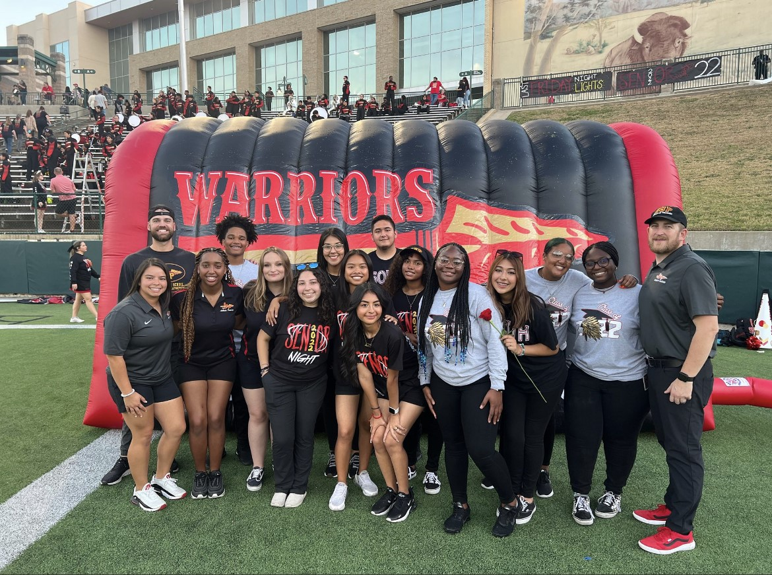
PAPERWORK
2025-2026 Physicals
PHYSICALS TURNED IN IMMEDIATELY (CAN NOT PRACTICE)
Report injuries to Athletic Trainers
https://grandprairieisd.rankonesport.com/New/NewInstructionsPage.aspx

Slide 6
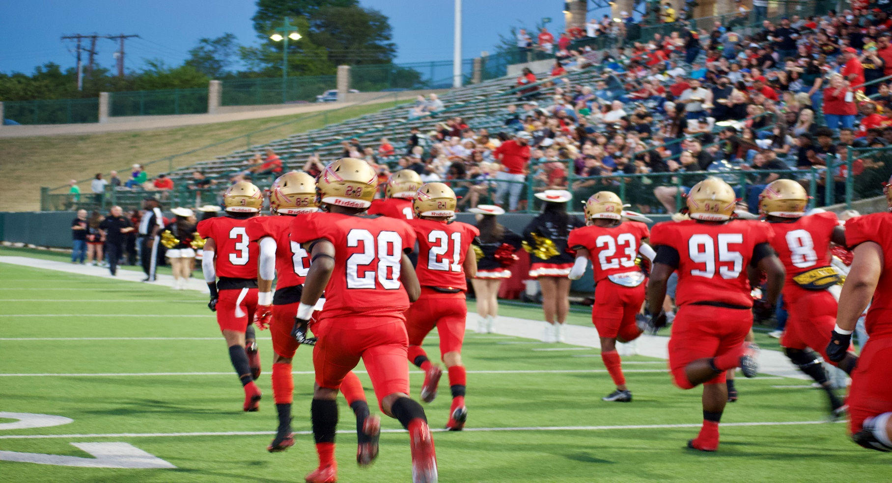
2025 SGP Warriors
UNITE AS ONE
  Brotherhood
  Family
  Team
  Community
  culture

Slide 7
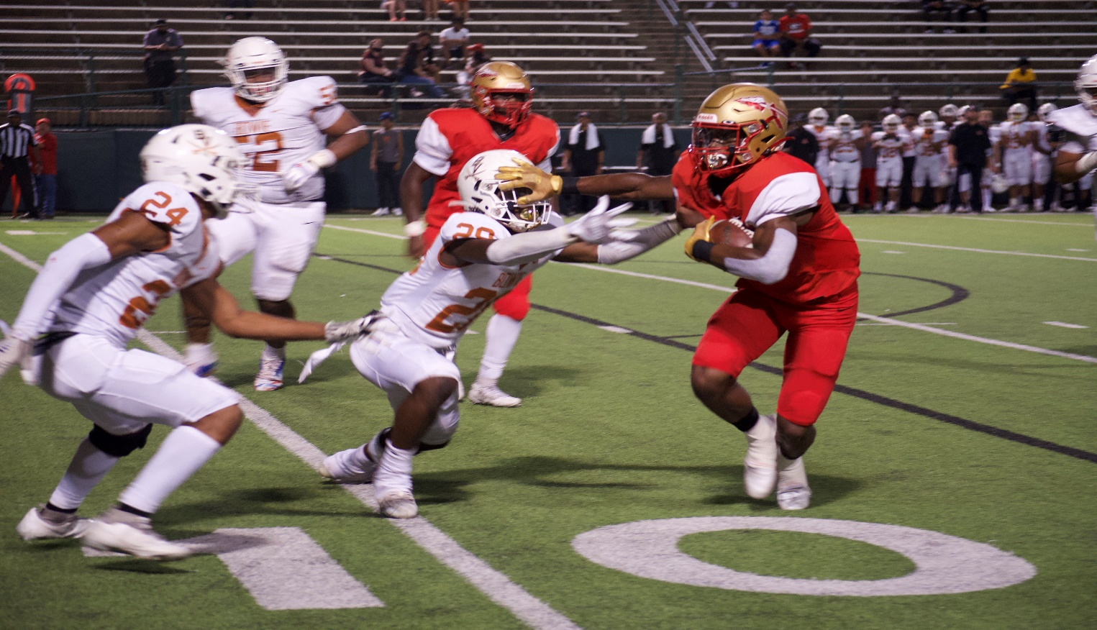
May/JUNE UPCOMING EVENTS
Physicals – May 17 (see flyer)
SUMMER PRIDE
  Begins June 2nd Monday-Thursday
  No workouts June 30-July 4
  Resumes July 7
  Times – 7:45-9:45am

Slide 8
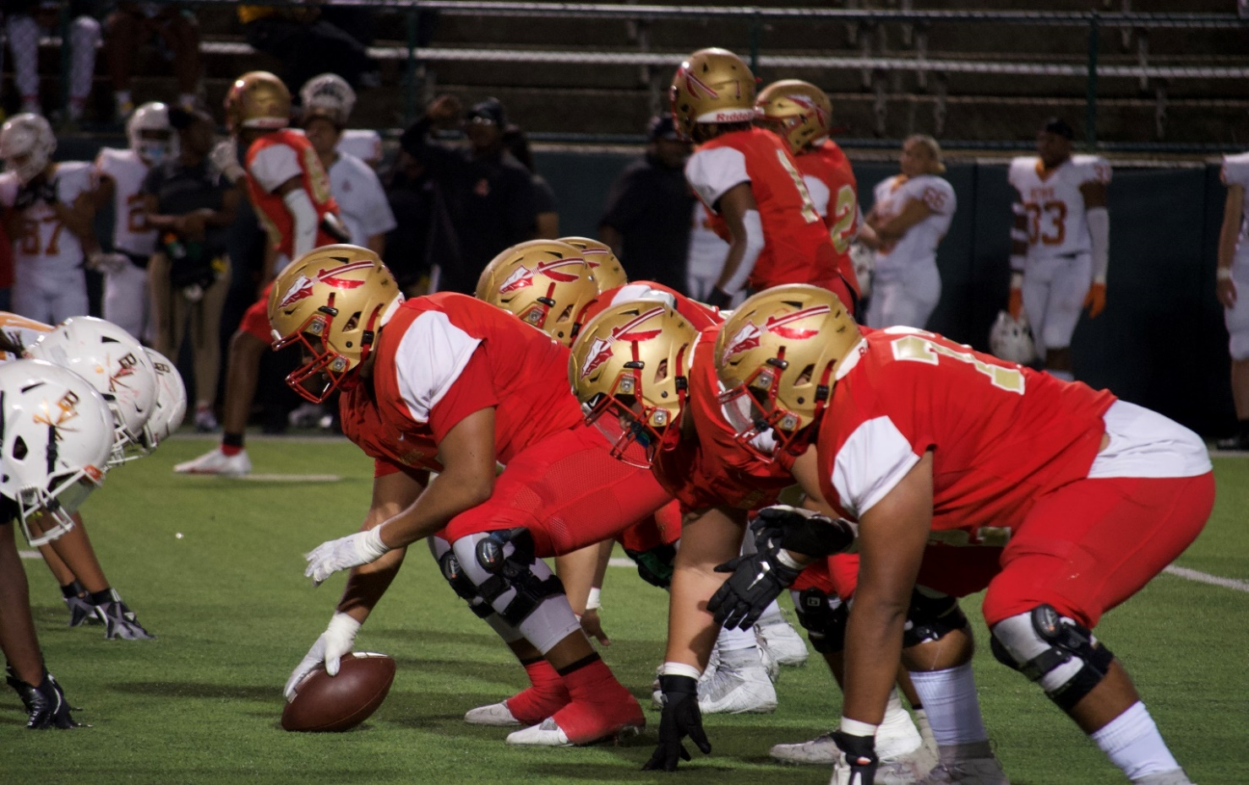
july / august
Freshman Equipment Issue – July 31 10:00am
Fall Camp (practices begin) –Aug 4
Aug 4 – Aug 8 7:00am – 9:00am
aug 5 Pictures 9:30am
Aug 8 fundraiser 9:30am
Aug 9 8:30am – 10:30am
*Aug 9 10:30am – 11:00am
* Watermelon Feed

Slide 9
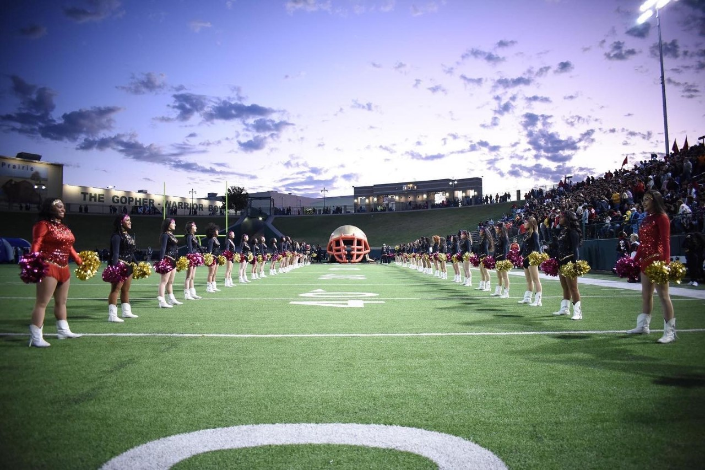
Season Practice Times once school has started
* Warriorpalooza: aug 20, 6pm @ sgp coliseum
Monday, Tuesday & Wednesday:
3:15pm-5:00pm
Thursday: typical Game Day
Friday: 7th period only
Sept 1 labor day morning practice

Slide 11
handouts
Warrior club calendar
Football schedules
Team store
Youth Football camp

Slide 12


Slide 13

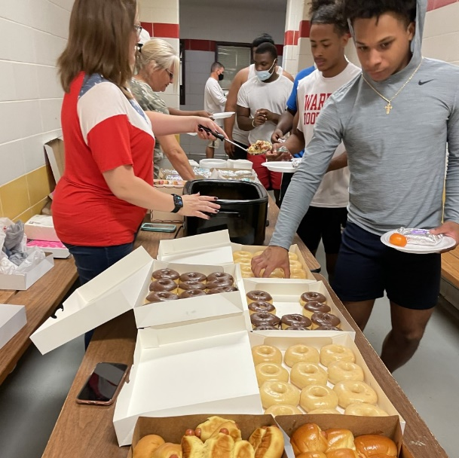
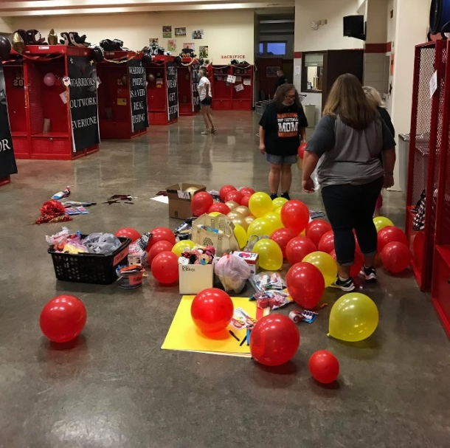
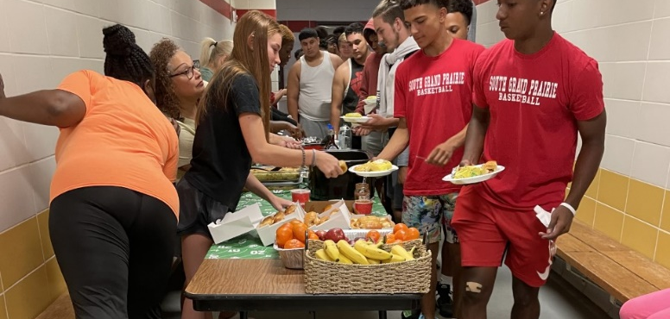
BOOSTER CLUB
Website: sgpwarriorbooster.wixsite.com/warriors
Facebook: http://www.facebook.com/SGPWarriorFootballBoosterClub/
Twitter: @SGPNation
Email: sgpwarriorbooster@gmail.com

Slide 14
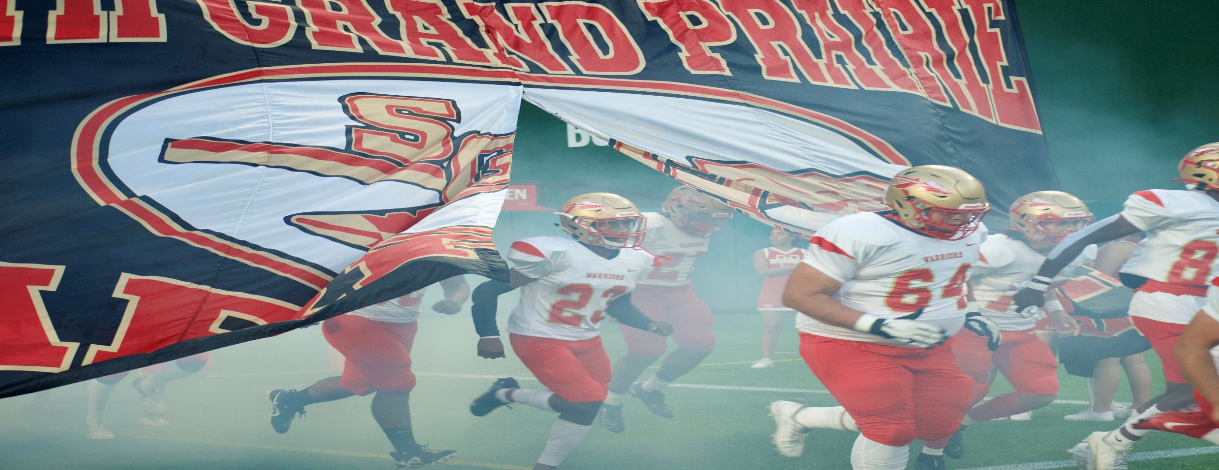
QUESTIONS

